Slide 1
ECO Frequency Information System (EFIS) Overview
CEPT Workshop on European Spectrum Management and Numbering
5 April 2016

Slide 2
What is EFIS – A first overview
Frequency information system that should show the actual spectrum use in CEPT countries – Mandated by EC (EC Decision for EFIS & Spectrum Inventory (Radio Spectrum Policy Programme)
Created in 2001 and administered by ECO
National information uploaded by the CEPT administrations
European Common Allocation Table and ITU Region 1 Allocations uploaded by ECO

Slide 3
Overview & general info
Tables/accounts available in EFIS:
45 countries, including all 28 EU Member States (Administrations upload their information)
ITU-R Region 1 Table
European Common Allocation (ECA) Table
TCAM table (R&TTE equipment subclasses 1 and 2 information, searchable by frequencies and/or applications)
Data types in EFIS:
Allocations - this is basically all the National Tables of Frequency Allocations, ECA and ITU Region 1
Applications – ECA and national frequency utilisation(applications) planning – more details than allocations
Radio interfaces (national radio interfaces and radio interface templates for ECC Decisions)
Documents (regulatory - Decisions /Recommendations) and non-regulatory (Reports, e.g. CEPT, ECC, questionnaire summaries etc.)
Right of use info
All data types are searchable and types 1 – 3 are comparable
for national as well as ECA and ITU tables

Slide 4
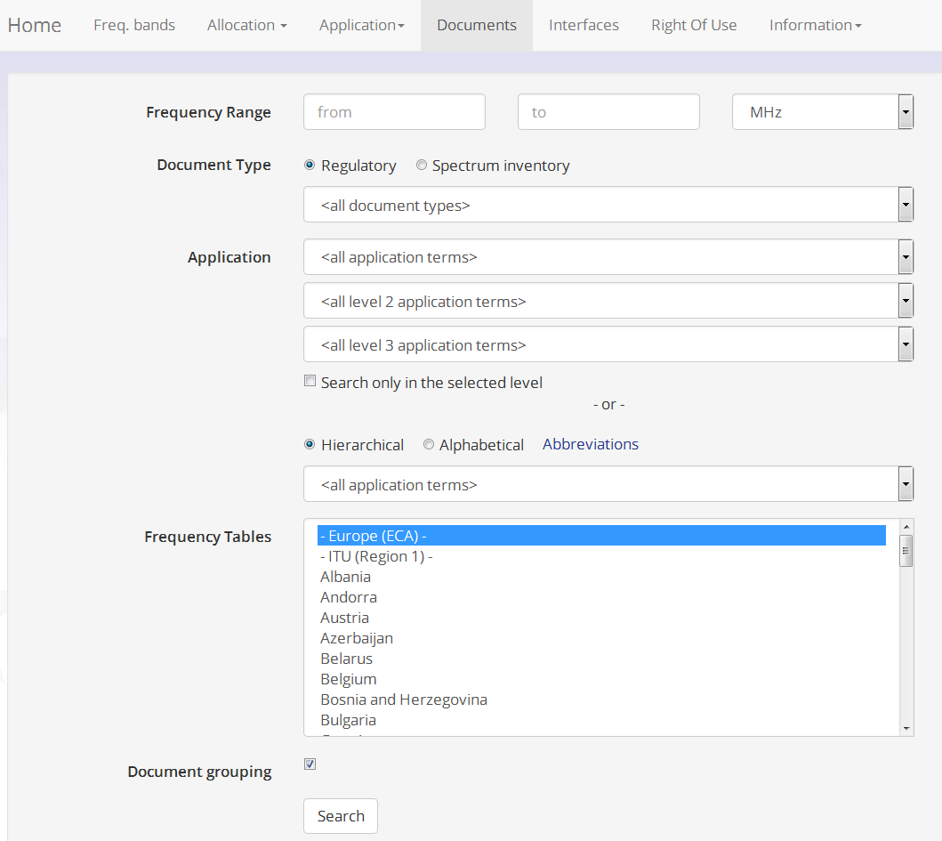

Slide 5
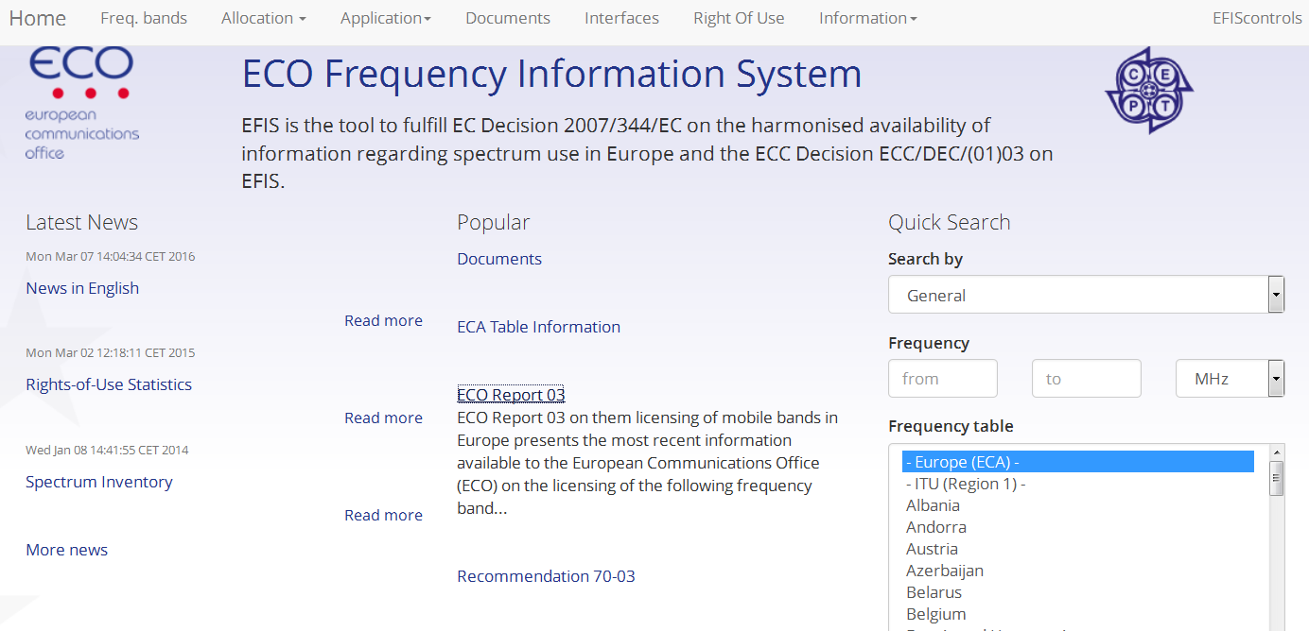
EFIS Home
New EFIS Design

Slide 6
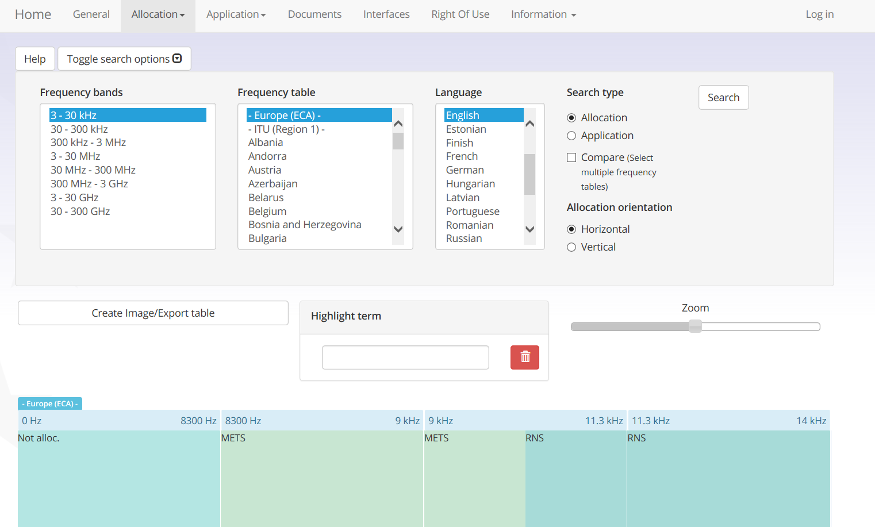
Also a graphical visualisation of allocations and applications

Slide 7
Some EFIS features
Graphical visualisations (allocations, applications, mobile licences, channelisation arrangements, implementation maps);
ECO Report 03 –information on licensing of mobile services in the EFIS (45 CEPT countries), including statistics;
ERC Recommendation 70-03 (SRDs) is fully generated out of EFIS;
The new ECO Report 04 on Fixed Service Implementation in Europe is also generated out of the EFIS database and includes the national implementation information for Fixed Service. This includes information on all current deliverables relevant for FS (and also FWA/ BFWA) including Harmonised European Standards, link to ITU-R Recommendations, ERC/ECC Decisions and Reports.

Slide 8
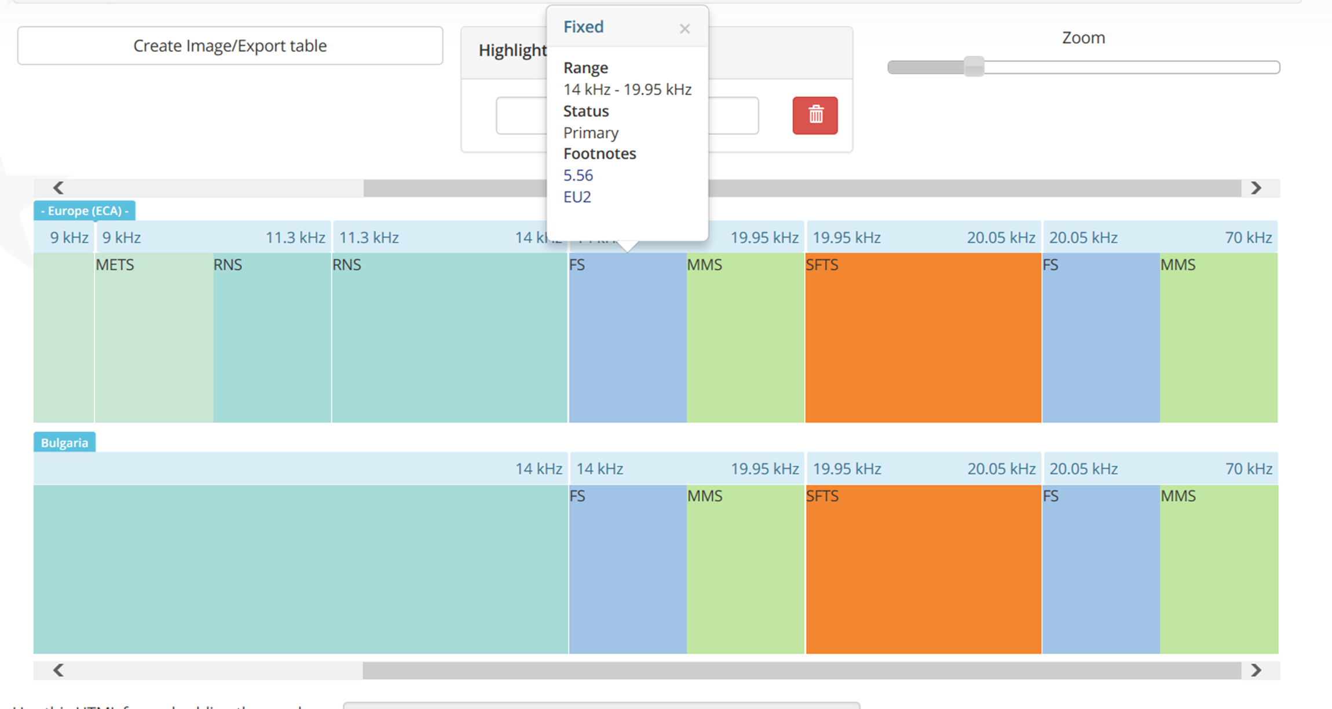
You can compare graphically the allocations or applications
of two or more countries

Slide 9
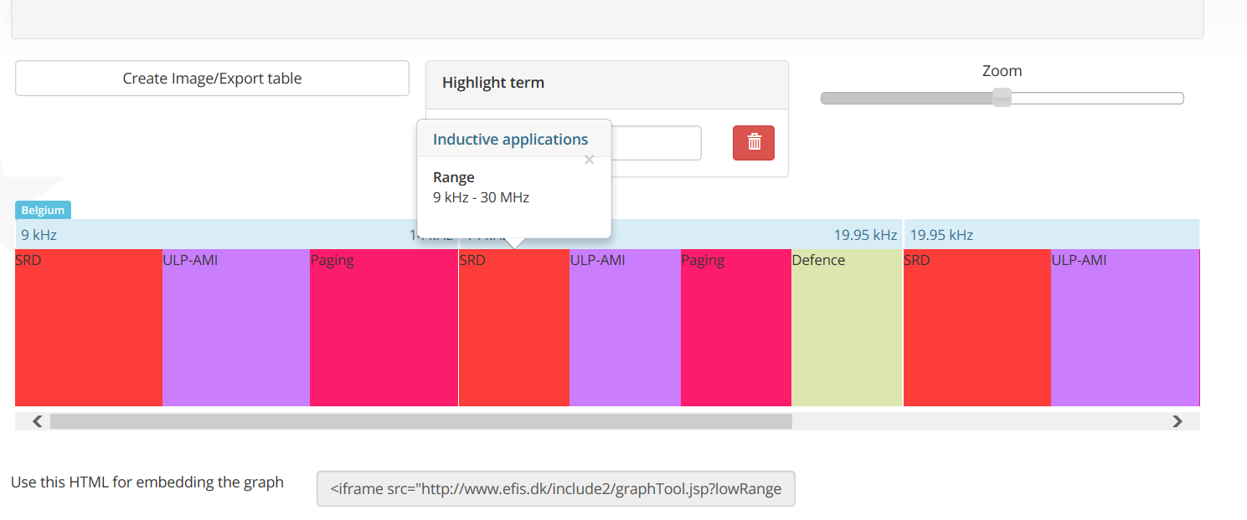
You can zoom, scroll, export picture/ table information, select
horizontal/vertical arrangement of entries, export a link/use the tool
externally

Slide 10
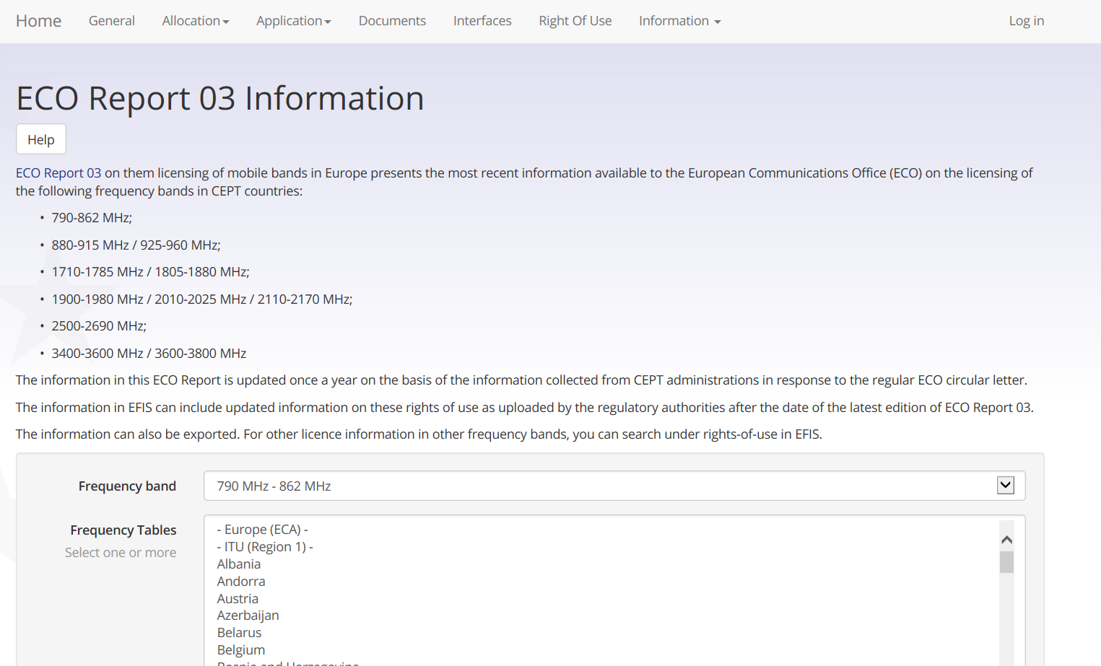
RoU for 45 countries in all ECS frequency ranges

Slide 11
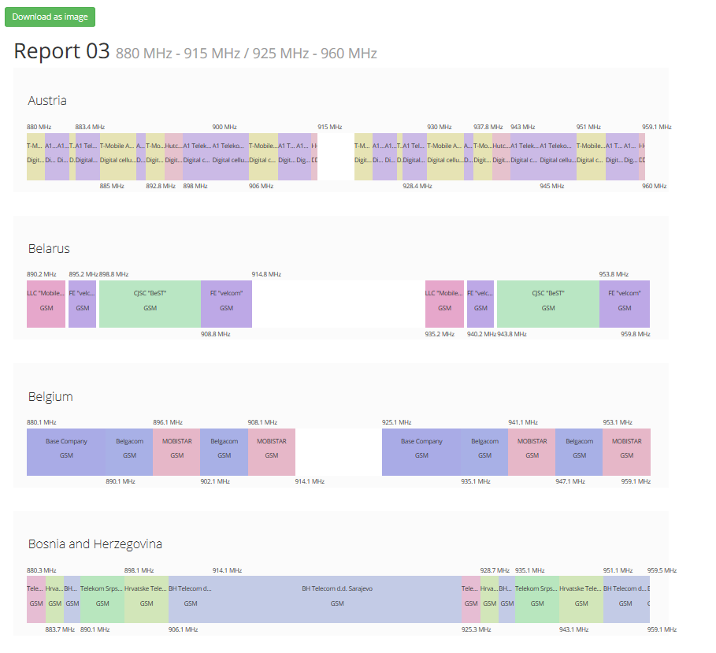

Slide 12
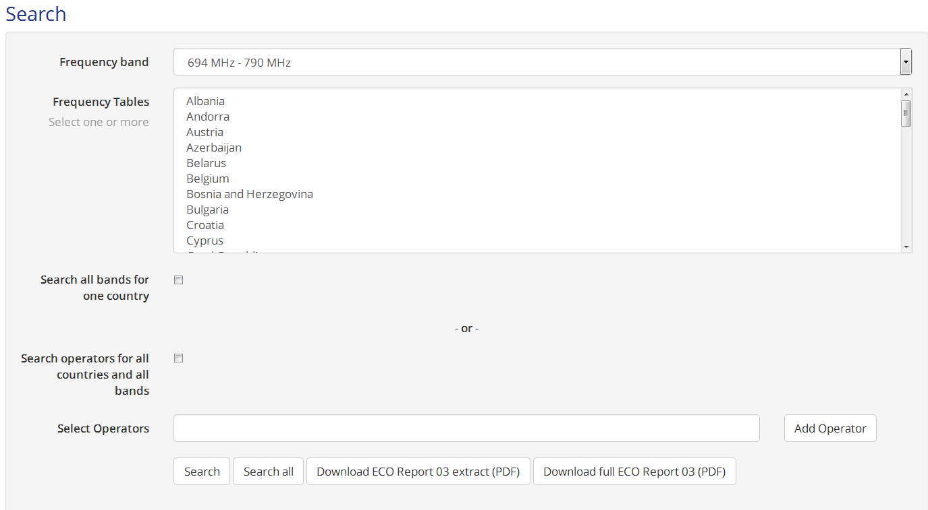
Search possibilities: Rights-of-Use – ECS bands

Slide 13
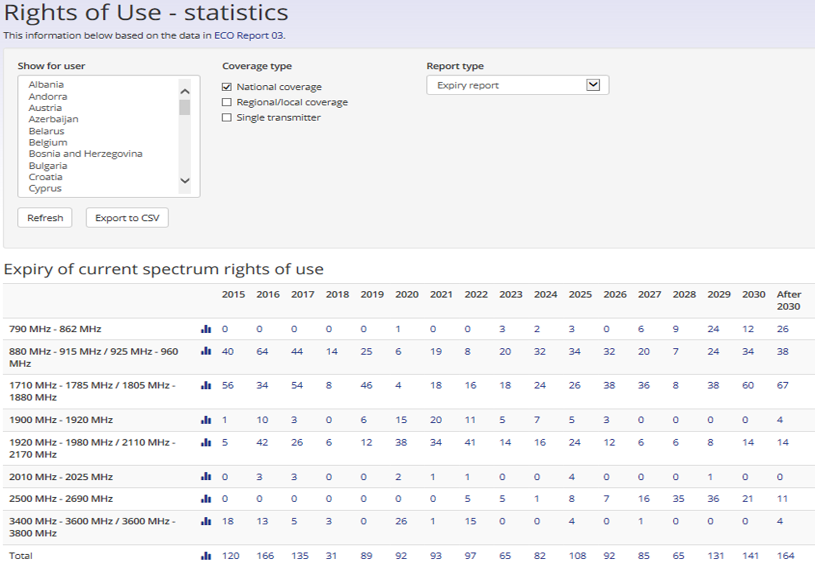

Slide 15
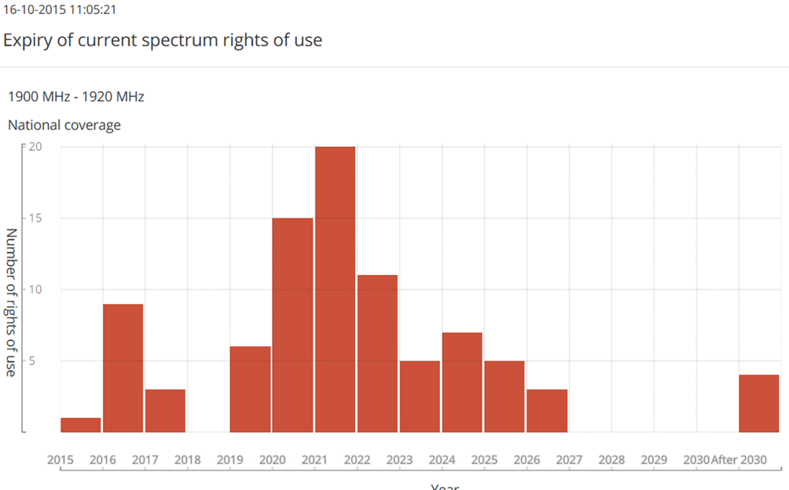
Rights-of-Use Statistics (Example)

Slide 16
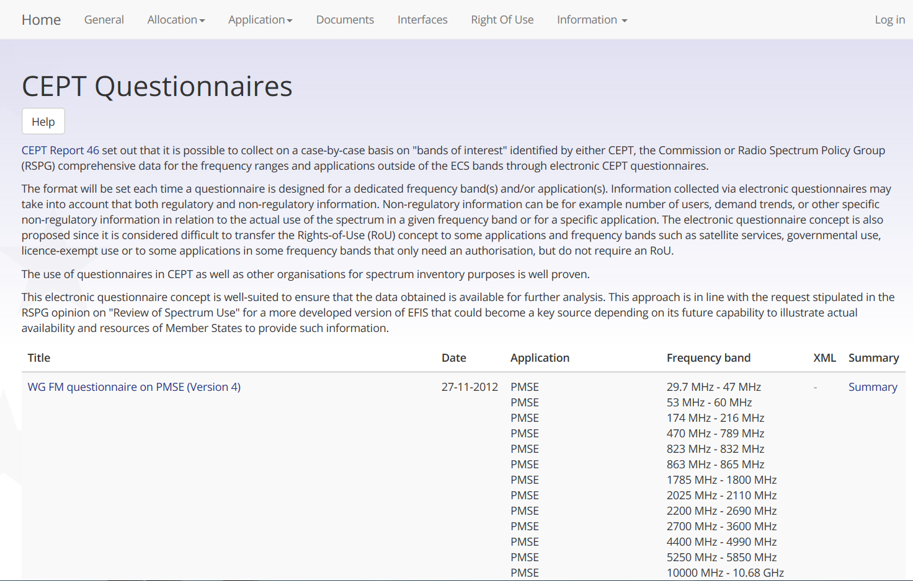
You can get the questionnaire summaries,
also linked to applications and frequency ranges

Slide 18
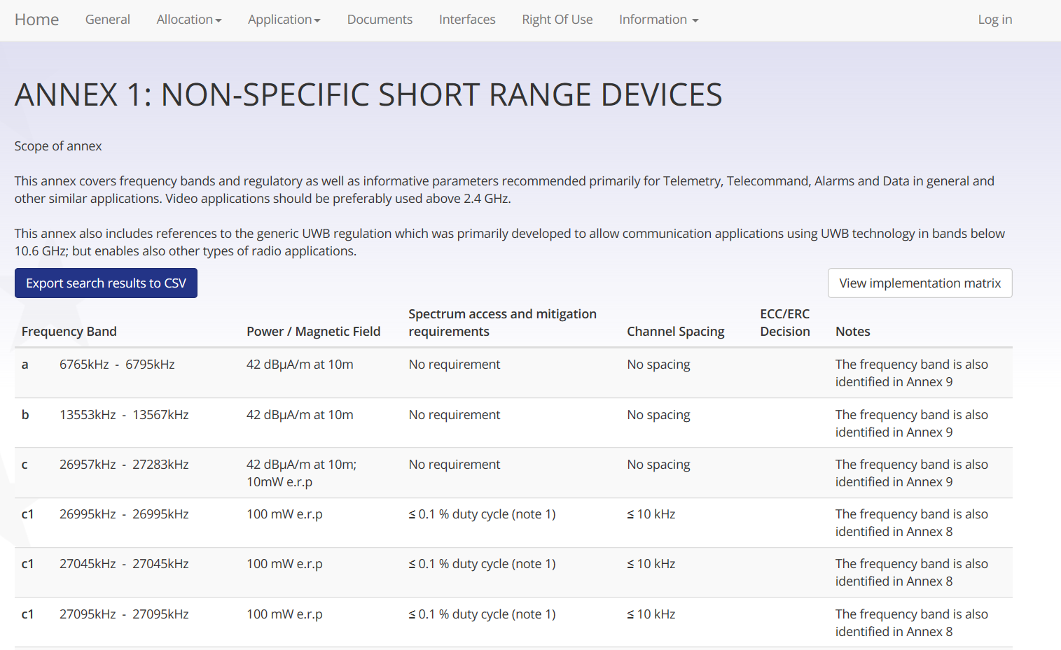

Slide 19
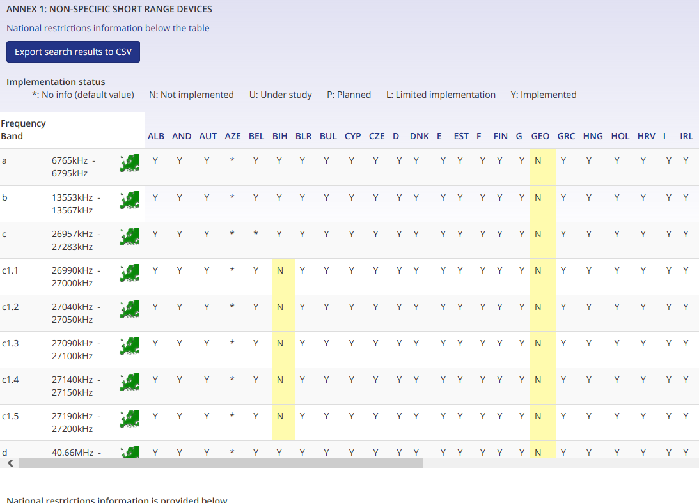
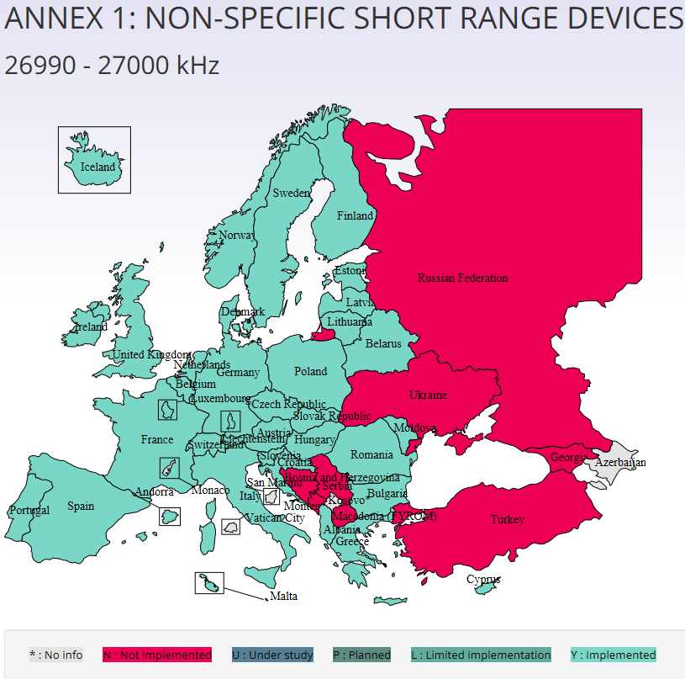
SRDs – Recommendation 70-03 (Example)

Slide 20
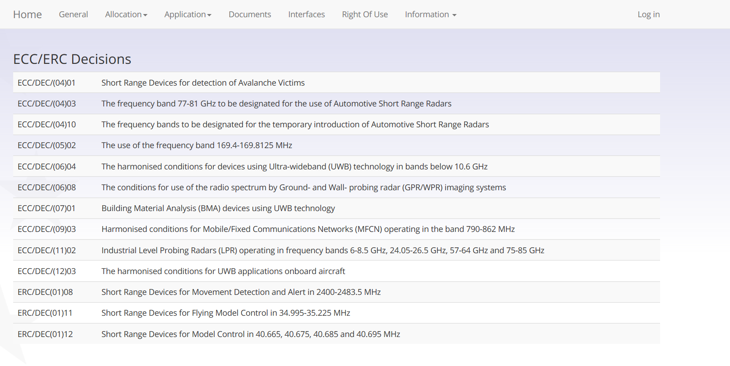
You can get via SRD in EFIS all related information,
here for example the related ECC Decisions)

Slide 21
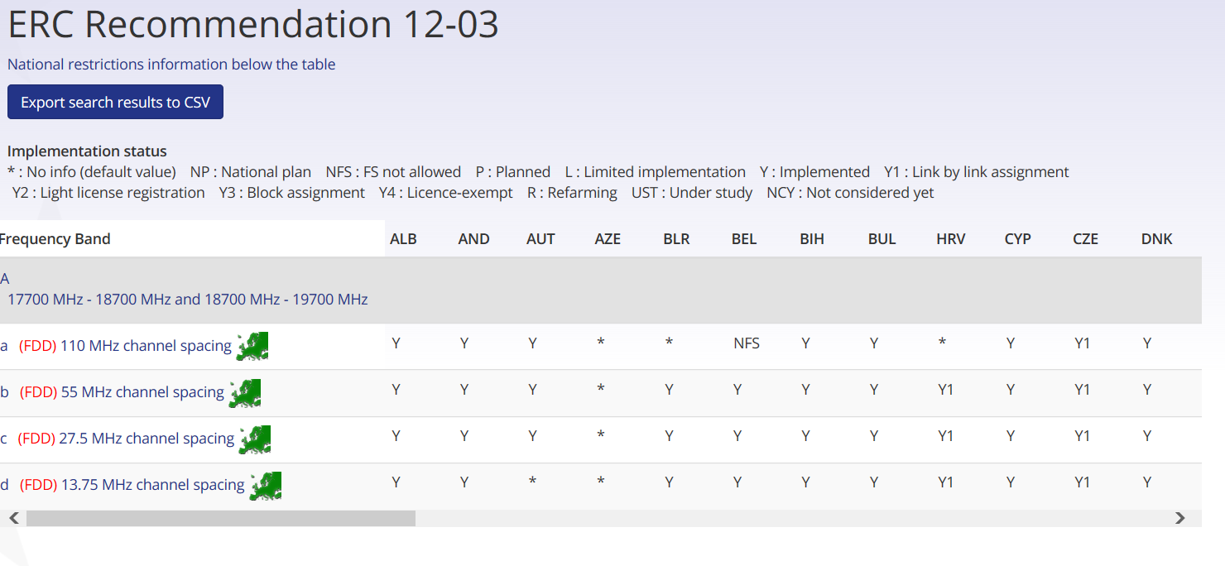
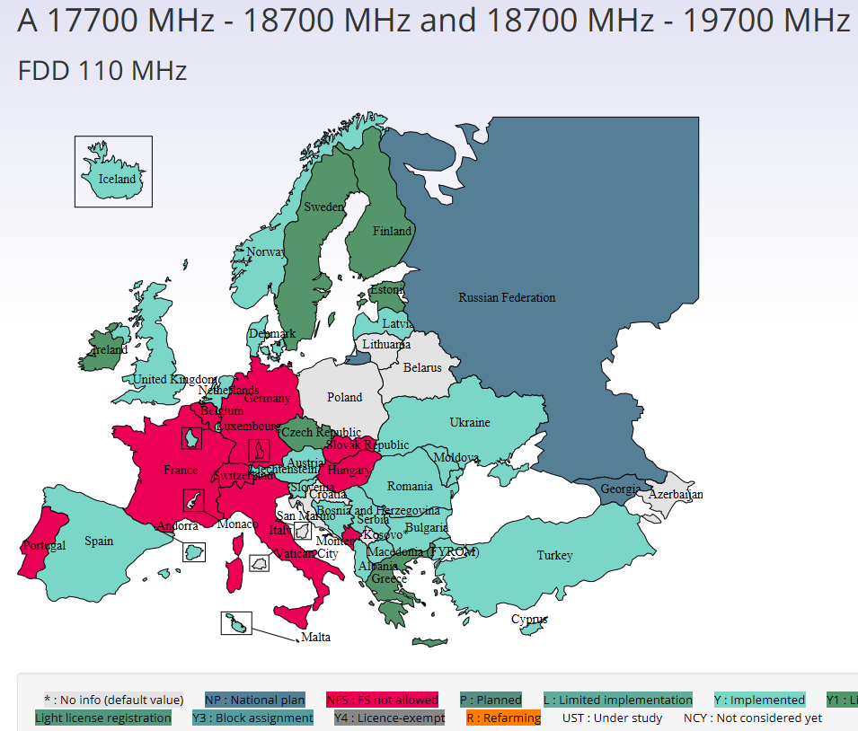
Fixed Service (Example)

Slide 22
Also Good to Know
The support for APT’s AFIS (APT Frequency Information System - http://www.aptafis.org/) continued in 2015. E..g. you find all the APT Reports and also SRD related information – helpful for European industry
Improvements of the information export functions (all selected information be exported)
Update history in EFIS
Full export of the ECA Table - European Common Allocation Table including footnotes, standards, application terminology
The graphical visualisation tool can also be separately used outside the EFIS database on other webpages (without the EFIS design)

Slide 23
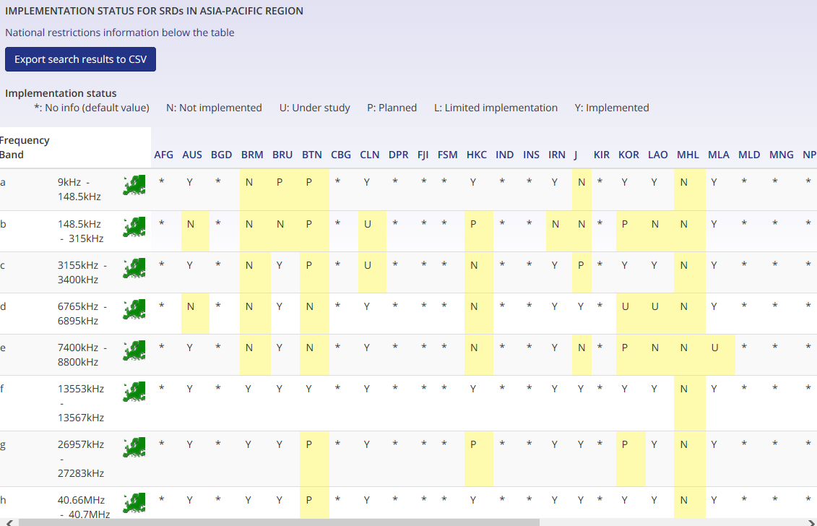
AFIS SRD (Example)

Slide 24
Sources of information/relevant documents for detailed guidance/information on EFIS
www.efis.dk and EFIS website page and www.ecodocdb.dk (all documents are available here)
ECC Report 180 on guidance on the interpretation of requirements in ECC/DEC/(01)03 (Revised September 2015)
ECC/DEC/(01)03 on EFIS
List of searchable allocations (Annex 1)
List of searchable applications (Annex 2) is updated as required (EFIS/MG proposes changes to WGFM, if appropriate)
ECO Report 05 (mapping of CEPT/ECC Deliverables and applications terminology)
(Published September 2015)

Slide 25
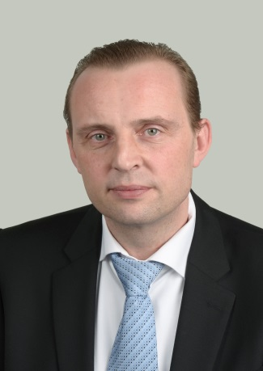
EFIS contacts in ECO
EFIS contacts in ECO
Bente Pedersen
Bente.pedersen@eco.cept.org
Tel: +45 33 89 63 11
Thomas Weber
Spectrum Management thomas.weber@eco.cept.org
Tel: +45 33 89 63 12
ECO
Nyropsgade 37, 1302 Copenhagen, Denmark Tel: +45 33 89 63 00 Fax: +45 33 89 63 30
eco@eco.cept.org

